Slide 1
Path to internets..

Slide 2
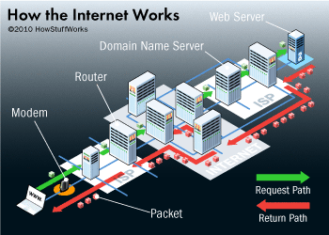

Slide 3
D
TLD’s Top-level domain

Slide 4
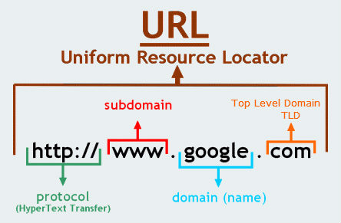

Slide 5
Domeno registravimas
.lt domenas:
domreg.lt
domreg.lt/public?pg=278B40
kiti (.com, .net, ..):
iana.org/domains/root/db
...

Slide 6
D
SERVER

Slide 7
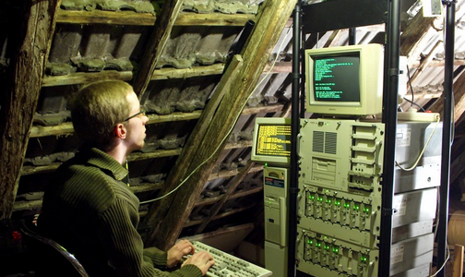
Running server from home

Slide 8
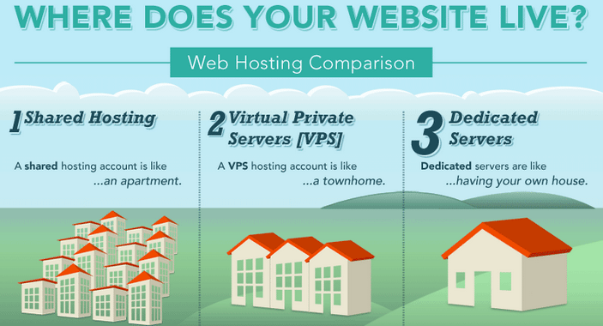
Web hosting

